Slide 1
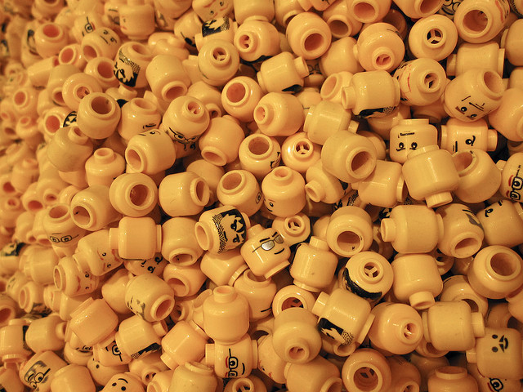
NONOSQL Architecture Patterns for Semantic Web Applications
Brian Panulla
Penn State Web 2011 Conference
Notes:
http://www.flickr.com/photos/mayhem/3104825022/in/photostream/

Slide 2
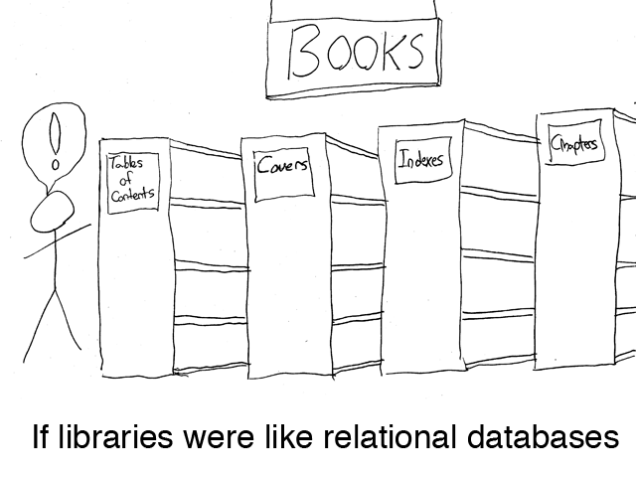

Slide 3
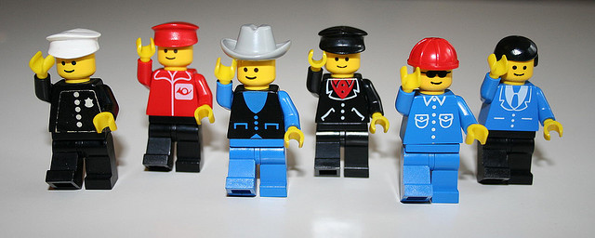
NoSQL: Key/Value and Graphs
Notes:
http://www.flickr.com/photos/herr_hartmann/448478567/in/photostream/
http://www.flickr.com/photos/mayhem/3104825022/in/photostream/

Slide 4
Technology Primer

Slide 5
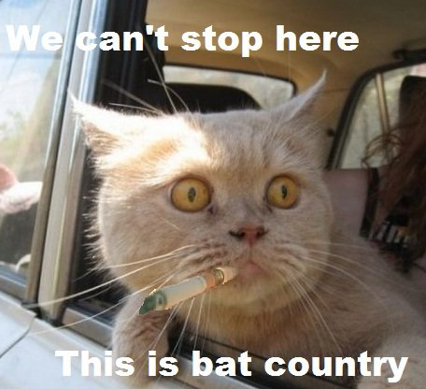
RDF: Framework for knowledge representation
Declares resources
Specifies properties of resources
W3C standard since 1999
http://www.w3.org/RDF/

Slide 6

RDF is not XML
...but occasionally dresses up like it
XML
N-Triples
N3
Turtle
JSON
RDFa
in HTML
...

Slide 7

What is a Resource?
Everything on the web (or not) is a resource.
Uniform
Resource
Locator

Slide 8
URIs
Resources are identified by a Uniform Resource Identifier (URI)
URIs are the Primary Key values of the Semantic Web

Slide 9
URIs
... Are not necessarily URLs
urn:isbn:951-611-441-5
http://brian.panul.la
http://google.com/portland/conferences/osb11

Slide 10
URIs
.. Can point to conceptual entities...
<span about=“...”>
<li typeof=“...”>
... Not material entities
<a href=“...”>
<link href=“...”>
<img src=“...”>
<base href=“...”>

Slide 11
URIs
2 resources with different URIs are assumed to be distinct by default.

Slide 12
Triples
RDF is expressed as triples of URIs:
subject (“Portland State”) - resource
predicate (”is a") - property
object (”University”) - resource
Is a
Portland
State
University

Slide 13
Triples
As RDF:
<http://www.pdx.edu>
rdf:type
<http://dbpedia.org/resource/University>

Slide 14
Triples
Another example:
subject (“Brian Panulla”)
predicate (”knows")
object (”Leif Warner”)
knows
Brian
Panulla
Leif
Warner

Slide 15
Triples
As RDF:
<http://github.com/bpanulla>
foaf:knows
<http://github.com/LeifW>

Slide 16
Triples to Graphs
NATO
State of
California
Member of
Member of
Is in
borders
United
States of
America
Is in
State of
Oregon
Is in
City of
Portland
Canada
Is in
borders
Held In
Is located in
Is in
Is in
State of
Washington
Portland
State
_{OSB11}
North
America
presented At
Is a
Brian
Panulla
attended
Is a
Penn
State
University

Slide 17
Triple Stores
Graph database built around RDF
Quad Stores: triple store that includes provenance
“where did the data come from?”
Options!
Transactional / non-Transactional
In-Memory / File system / RDBMS storage

Slide 18
Popular Triple Stores
Apache Jena
Franz AllegroGraph (server)
Virtuoso Universal Server (server)
Mulgara (RESTful service)
Redland (embedded C, Obj-C)
New
Stardog - Integrated reasoning database
RDFa API - https://github.com/webr3/rdf.js

Slide 19
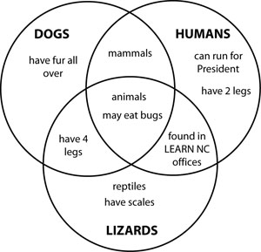
RDF Schemas
RDFS provides limited Set Theory features
subClassOf
subPropertyOf
Domain
Range
Think of classes in RDFS as sets rather than OOP classes

Slide 20

Defining an ontology
Web Ontology Language (OWL)
Version 2.0
(October 2009)
http://www.w3.org/TR/owl2-overview/
Yes, rly.
Notes:
http://www.flickr.com/photos/jingleslenobel/4971486823

Slide 21
Some RDFS/OWL Features
Classes
Sub-class
Equivalent Classes
Disjoint Classes
Cardinality constraints (max/min)
Individuals
Same Individual
Properties
Sub-property
Equivalent
Inverse
Symmetric
Transitive

Slide 22
Semantic Web Architecture

Slide 23
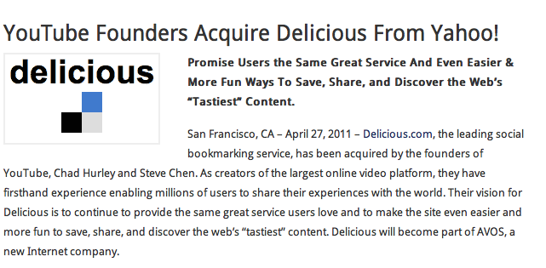

Del.icio.us

Slide 24
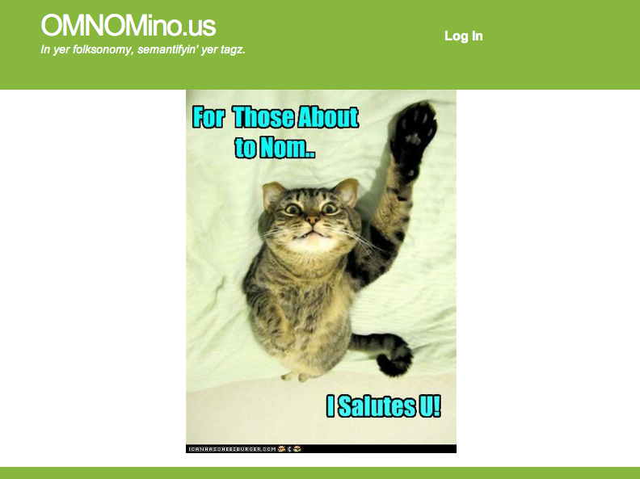
OMNOMino.us

Slide 25
Basic Requirements
Information
People
Bookmarks
Tags
Functionality
Create an account
Add a bookmark
Delete a bookmark
Browse other users’ bookmarks

Slide 26
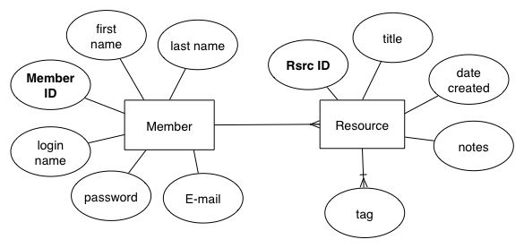
Logical Schema

Slide 27
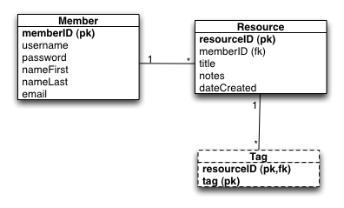
Relational DB - Physical Schema

Slide 28
Modeling in RDF
Re-use existing schemas or ontologies where appropriate

Slide 29
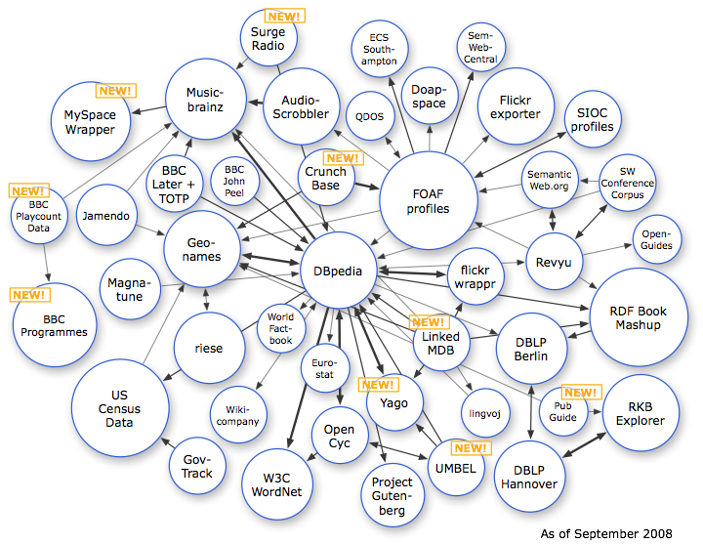
Linked Data - 2008
http://richard.cyganiak.de/2007/10/lod/

Slide 30
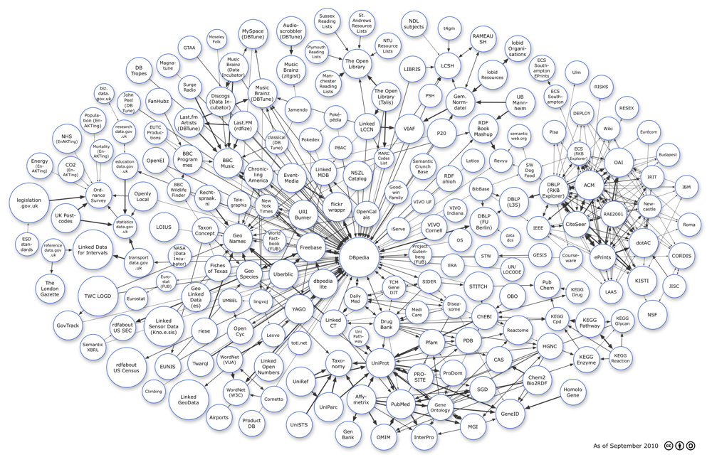
Linked Data - 2008
http://richard.cyganiak.de/2007/10/lod/ Last updated: 2010-09-22

Slide 31



Useful Schemas
Dublin CORE METADATA INITIATIVE (DCMI)
FrienD-of-a-friend
(FOAF)

Slide 32
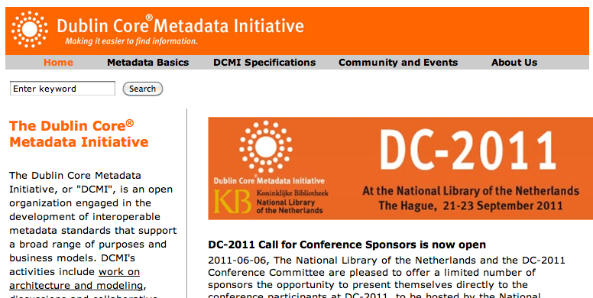
DMCI

Slide 33
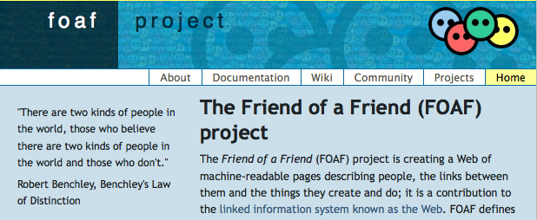
FOAF
Well-defined ontology for people, organizations, and social networks

Slide 34
RDF Data Model - Member
foaf:Person
foaf:fullname
foaf:nickname
foaf:mbox
foaf:openid
Literal (“datataype”)properties
Resource (“object”)
property

Slide 35
RDF Data Model - Bookmark
foaf:Document
dct:title
dct:description
dct:created
dct:modified
foaf:page
foaf:topic
Literal (“datataype”)properties
Resource (“object”)
properties

Slide 36
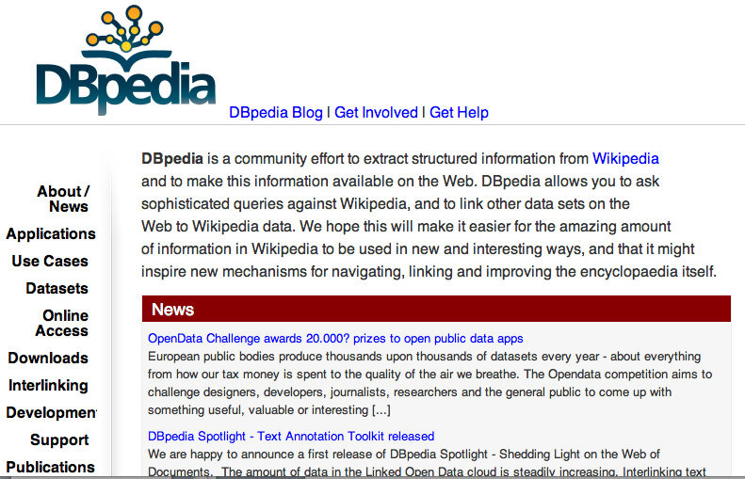
Topics from DBPedia
Semantified Wikipedia

Slide 37
Custom properties and classes
omnom:bookmarked
http://omnomino.us/ontology/om.n3#bookmarked
omnom:
bookmarked
foaf:
Person
foaf:
Document

Slide 38
Custom properties and classes
foaf:
Person
foaf:
Document
rdfs:
subClassOf
omnom:
Member
omnom:
Resource

Slide 39
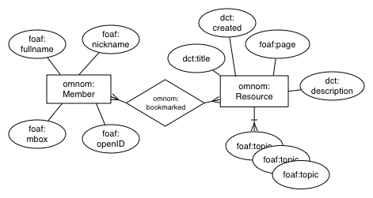
RDF Data Model

Slide 40
SPARQL
Graph query language
Read-only (1.0)
Safe to expose endpoint to Web
SPARQL 1.1 adds updates

Slide 41
A Simple SPARQL Example
SELECT ?subj ?pred ?obj
WHERE {
?subj ?pred ?obj.
}
Demo

Slide 42
SPARQL Examples: Member
SELECT DISTINCT ?uri ?fullname ?nickname ?email
WHERE {
?uri a omnom:Member.
OPTIONAL {
?uri foaf:name ?fullname;
foaf:nick ?nickname;
foaf:mbox ?email.
}
FILTER (?uri = <http://omnomino.us/member/24601>)

Slide 43
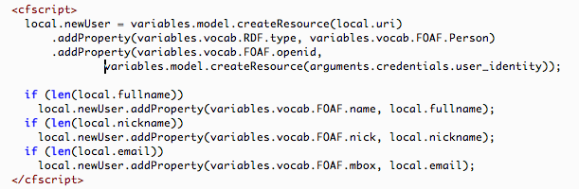
Updates via API

Slide 44
Resources
Semantic Web Programming - John Hebeler, Matthew Fisher, Ryan Blace, and Andrew Perez-Lopez
Semantic Web for the Working Ontologist: Effective Modeling in RDFS and OWL -Dean Allemang and James Hendler
Programming the Semantic Web by Toby Segaran, Colin Evans, and Jamie Taylor

Slide 46
Backup

Slide 47
Three things the Semantic Web is not (mostly)

Slide 48
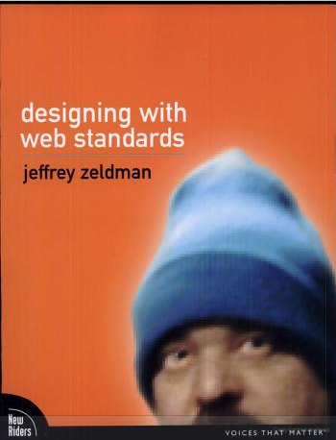
1. Semantic HTML

Slide 49
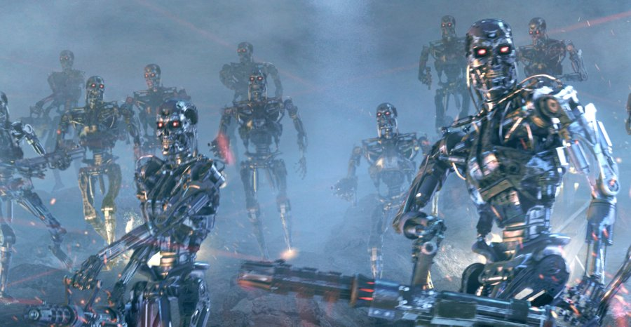
2. Warmed-over AI
http://www.movieprop.com/tvandmovie/terminator/t3endoskeletons1.jpg

Slide 50
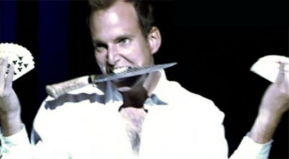
3. Magic
http://bostonist.com/attachments/Anna%20Edwards/109-gob-magic2.jpg

Slide 51
Who cares?

Slide 52
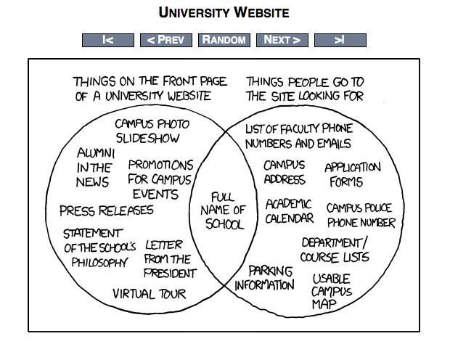
Semantic
Web
http://xkcd.com/773/

Slide 53
On NoSQL...

Slide 54
On Linked Data...

Slide 55
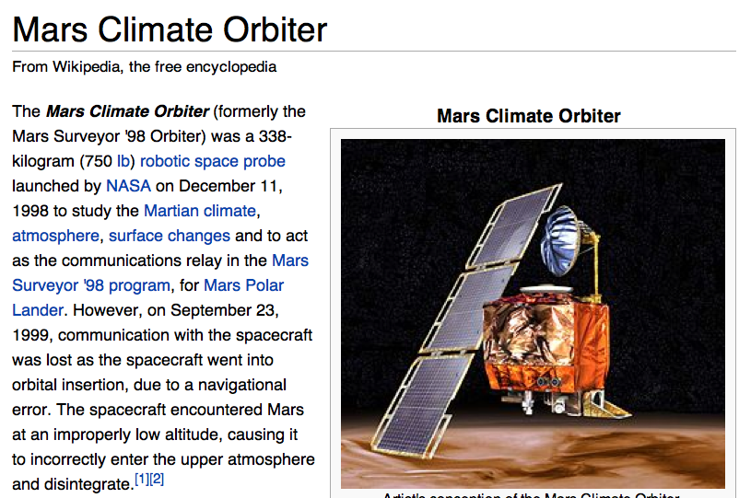

Slide 56
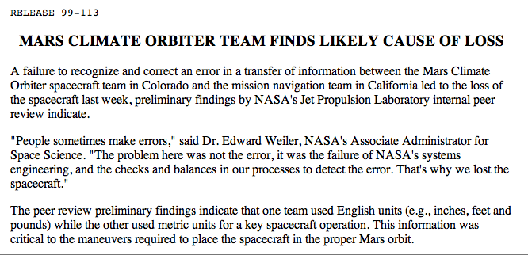
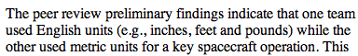
When things go wrong

Slide 57
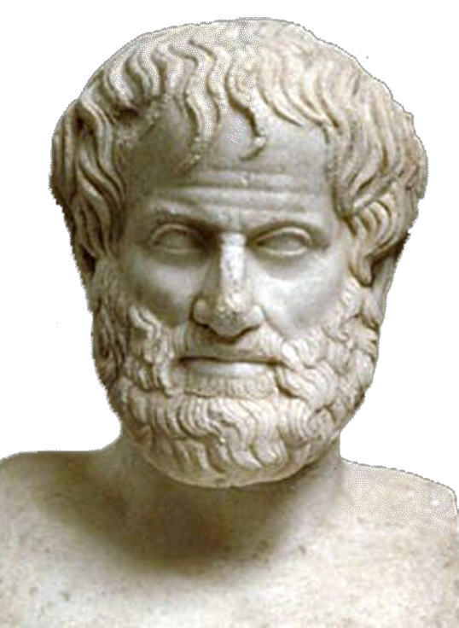
Ontologies
Ontology is the study of being or reality.
A Formal Ontology is a specification of a conceptualization (Gruber, 1995)
Aristotle ➔

Slide 58
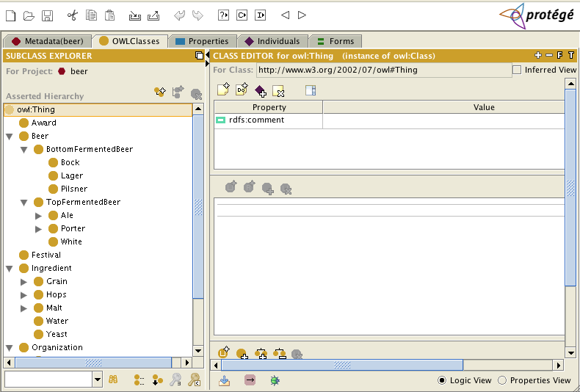
Protégé http://protege.stanford.edu/

Slide 59
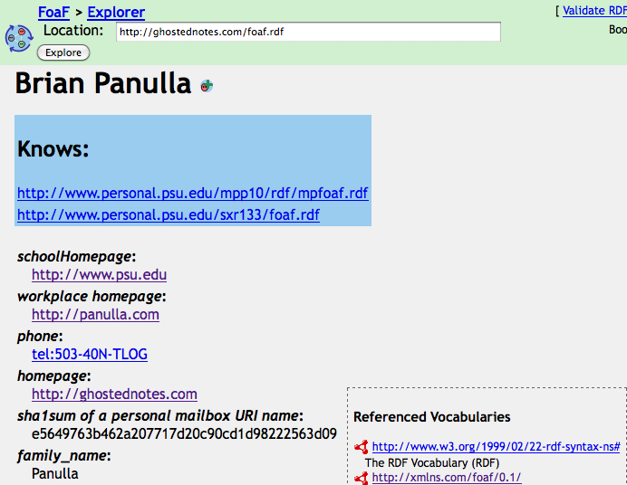
FOAF

Slide 60
The Good:
Domains where schemas/models change rapidly or data is sparse
Semantics of relational model inadequate (e.g. inferencing, inheritance)
Domains emphasizing relationships
Social networks
Taxonomies

Slide 61
The Bad:
Weaknesses
Alternatives
Bad for opaque objects with few relationshps
Large sets of homogenous objects
RDBMS
NoSQL
Document DBs
Key/Value Stores
Graph databases

Slide 62
Linked Data
Publish/Syndicate complete information sets
Embedded explicit semantics, unique identifiers
Have minimal impact to other Web information publishing
May be static or dynamically generated

Slide 63
SPARQL Query Types
SELECT – Returns tuples matching specified pattern
ASK – yes or no (tests for existence)
CONSTRUCT – Returns a graph
DESCRIBE – Returns a graph determined by the query engine

Slide 64
SPARQL Examples: ASK
ASK {
?uri foaf:openid <http://brian.panul.la>.
}

Slide 65
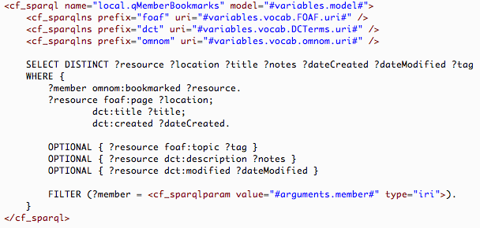
SPARQL Example: Bookmarks

